Slide 1
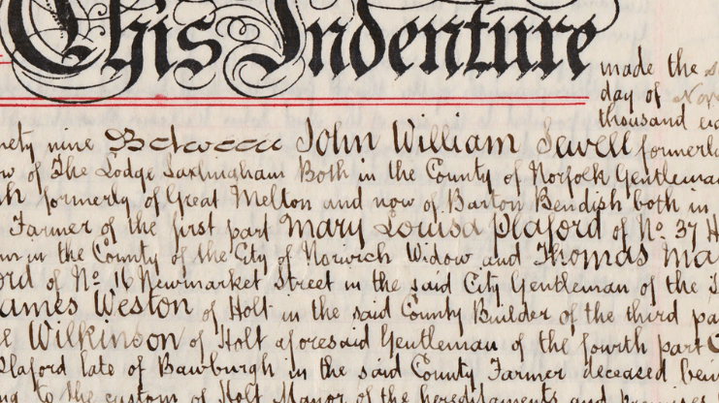
ADD TITLE
Smart Document
Add Subtitle

Slide 2
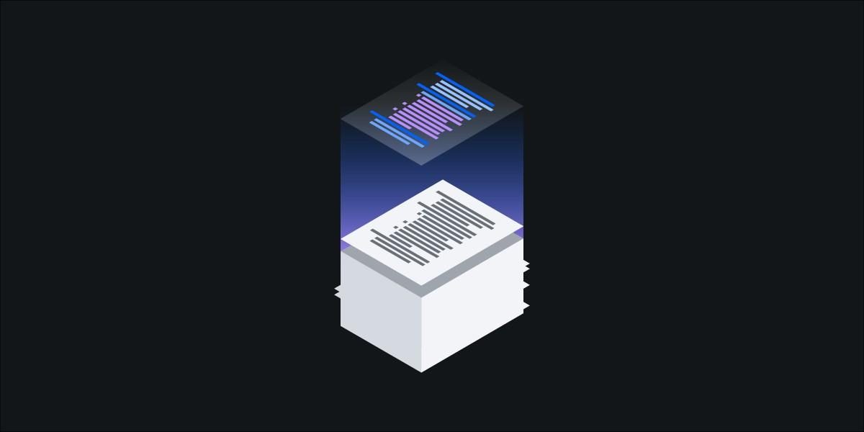
SMART DOCUMENT
A smart document is a application that can be used to convert a handwritten document to text file.
Since handwritten text lines are generally skewed and not obviously separated, text line segmentation of the handwritten document is used.
Paragraph
Line Segment
Single Word

Slide 3
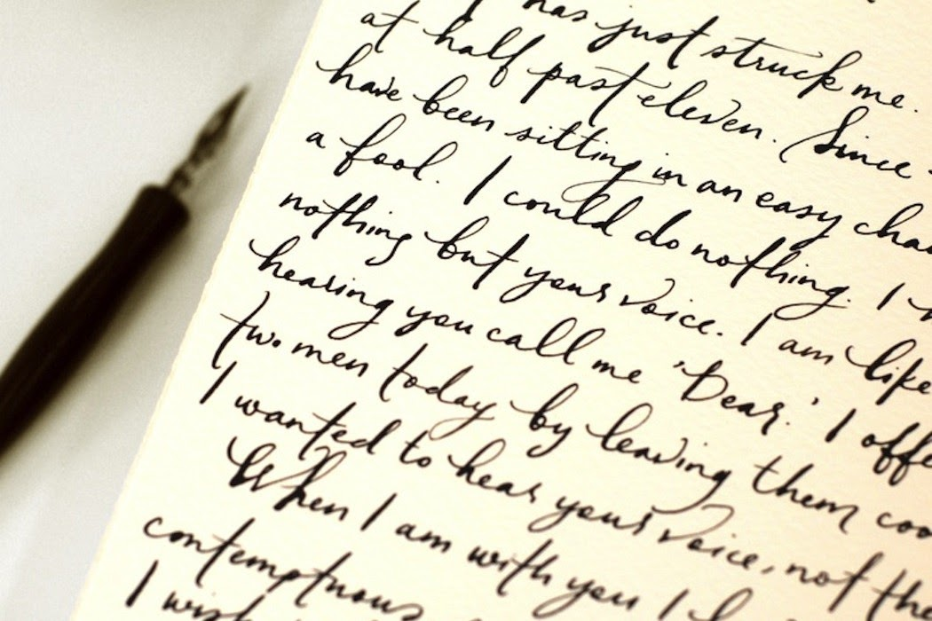
HANDWRITING RECOGNITION
Handwriting recognition (HWR), also known as Handwritten Text Recognition (HTR), is the ability of a computer to receive and interpret intelligible handwritten input from sources such as paper documents, pictures.
Handwriting recognition using deep learning is a very powerful technique for several reasons: Our approach of feeding in random patches makes the model text independent High prediction accuracy makes it possible to use this in practical applications

Slide 4

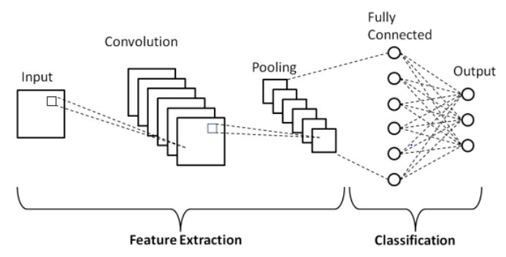

METHODOLOGY

Slide 5
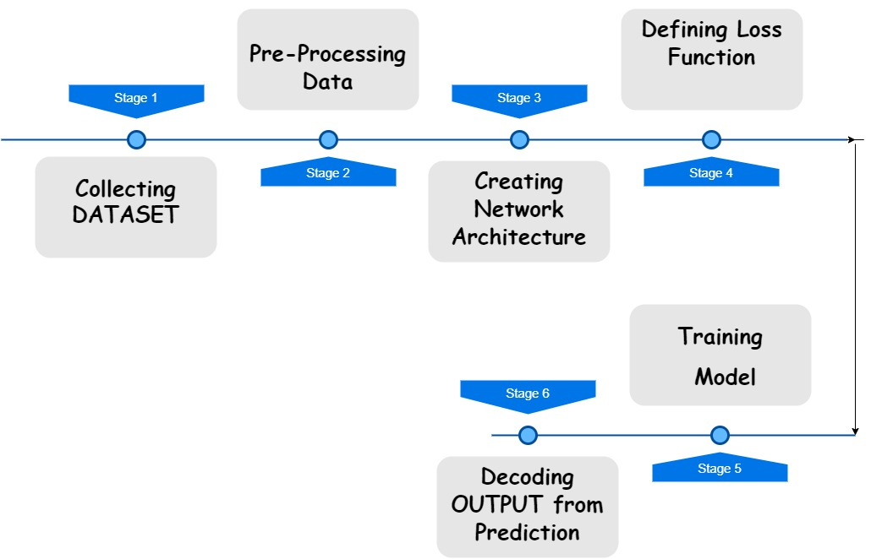
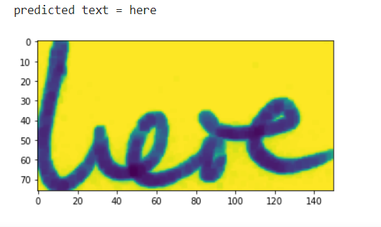

Slide 6
METHODOLOGY
An optical character recognition problem is basically a type of image-based sequence recognition problem. And for sequence recognition problem, most suited neural networks are recurrent neural networks(RNN) while for an image-based problem most suited are convolution neural networks(CNN). To cop up with the OCR problems we need to combine both of these CNN and RNN
We can break the implementation of CRNN network into following steps:
Collecting Dataset
Preprocessing Data
Creating Network Architecture
Defining Loss Function
Training Model
Decoding Outputs from Prediction

Slide 7
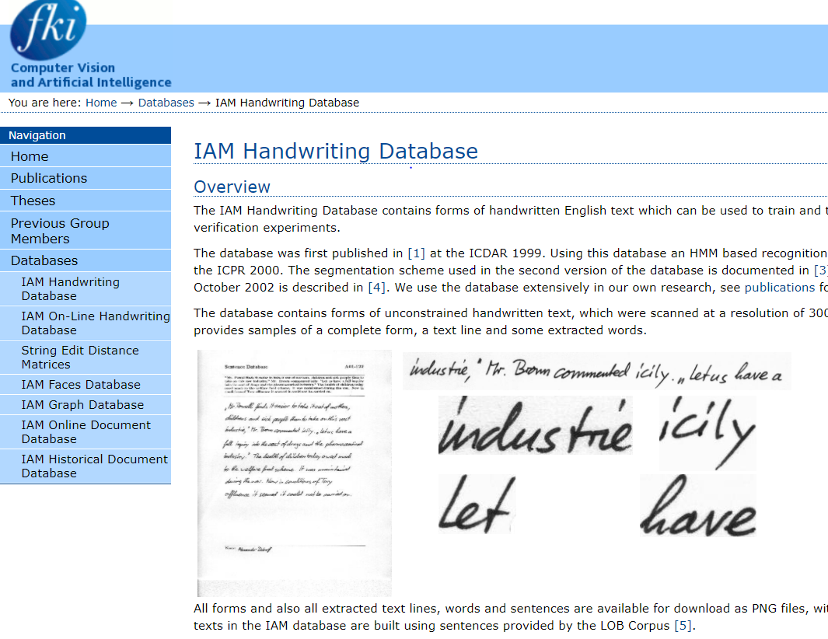
DATASET

Slide 8
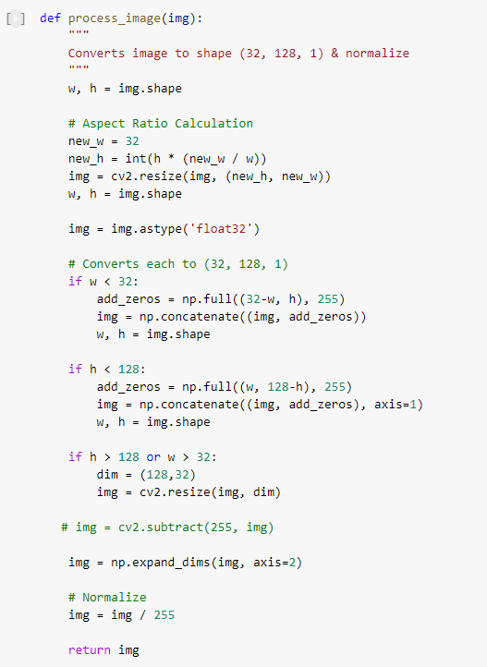
PRE-PROCESSING
Now we are having our dataset, to make it acceptable for our model we need to use some preprocessing. We need to preprocess both the input image and output labels. To preprocess our input image we will use followings:
Read the image and convert into a gray-scale image
Make each image of size (128,32) by using padding
Expand image dimension as (128,32,1) to make it compatible with the input shape of architecture
Normalize the image pixel values by dividing it with 255.

Slide 9
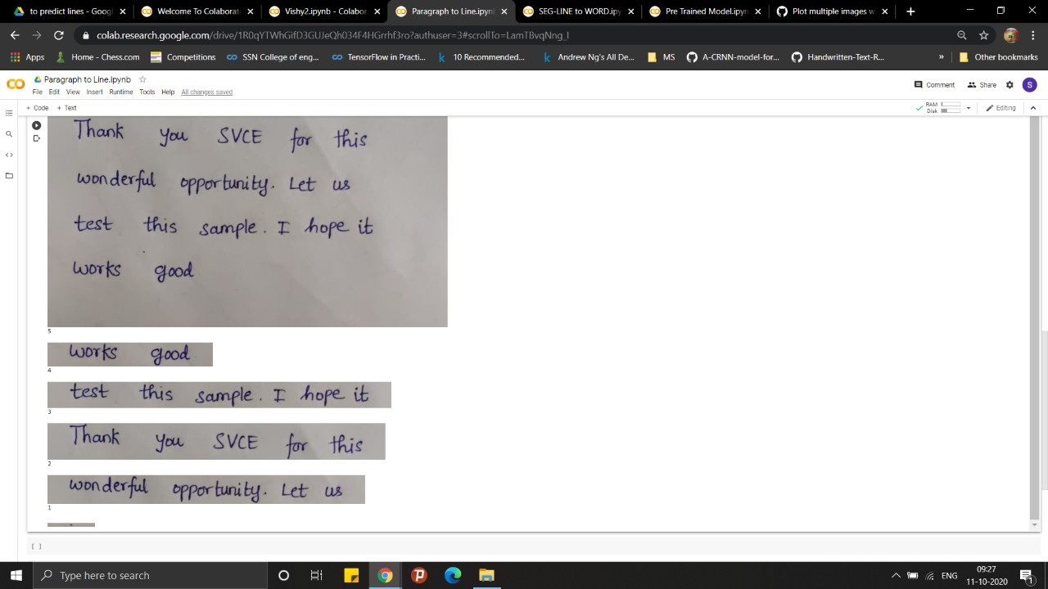
PARAGRAPH TO LINE SEGMENTATION

Slide 10
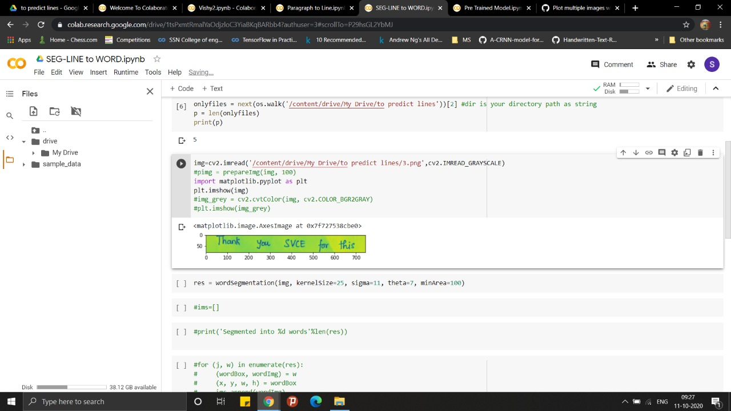
LINE SEGMENT TO SINGLE WORD

Slide 11
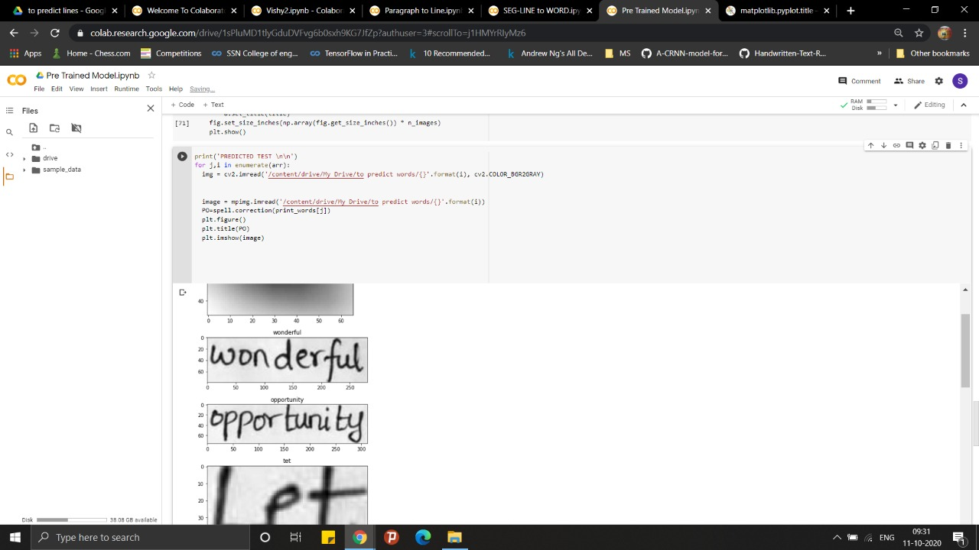

Slide 12
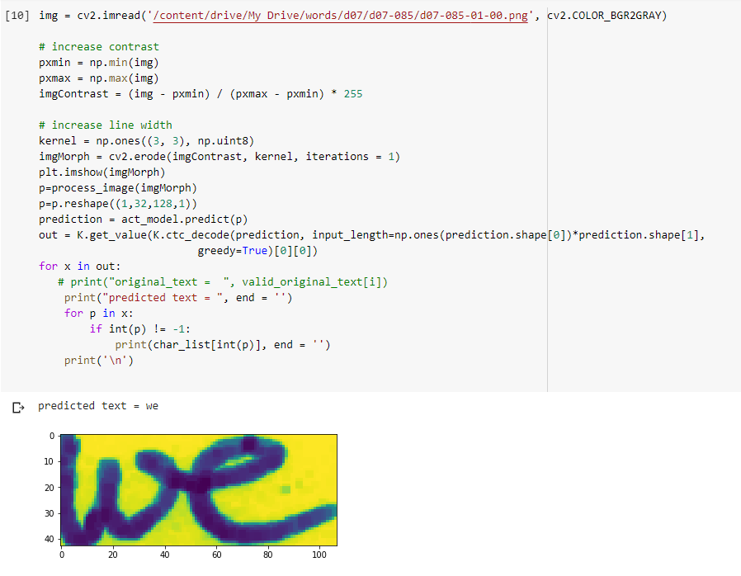
DECODING OUTPUTS FROM PREDICTION

Slide 13
USE CASE
Appliations
Healthcare and pharmaceuticals
Patient prescription digitization is a major pain point in healthcare/pharmaceutical industry. For example Roche is handling millions of petabytes of medical PDFs daily. Another area where handwritten text detection has key impact is patient enrollment and form digitization. By adding handwriting recognition to their toolkit of services, hospitals/pharmaceuticals can significantly improve user experience
Banking
People write cheques on a regular basis and cheques still play a major role in most non-cash transactions. In many developing countries, the present cheque processing procedure requires a bank employee to read and manually enter the information present on a cheque and also verify the entries like signature and date. As a large number of cheques have to be processed every day in a bank a handwriting text recognition system can save costs and hours of human work

Slide 14
PROJECT BY:
TECH THUGS
RASHMIKA B
SANDHIYA S
DHEEPIKA P
VISHVAMBAR PANTH
SARAVANA KUMAR

